Slide 1
CIST 3222 – Database Systems Group Project Presentation Coastal Land Contractors, Inc.
Presented by Group 3:
Timothy Sands, Leonardo Acefe, Jay An, and Long Nguyen

Slide 2

Business Overview
Our company is Coastal Land Contractors, Inc., based on a real company owned and operated by Tim’s family.
This small business is responsible for contracting jobs in local construction.
Knocking out walls, constructing additions to buildings, reconstructing existing structures

Slide 3
Problems, Opportunities, and Objectives
Problems: Without our implementation, Coastal Land Contractors, Inc. would normally record data and information on paper. Paper records creates confusion and inefficiencies when recalling specific instances of data and information.
Opportunities: By using a digital database, our company will save time on searching and use the extra time to devote to their contracts.
Objectives: Our digital database will be implemented to be accessible to our company. Necessary data can be pulled quickly and efficiently.

Slide 4


Business Case
The new database will help our company work more efficiently, by saving time that would be otherwise spent on digging through paperwork.

Slide 5
Information and Data Requirement
Inventory, Equipment, and Vehicle management
Materials on hand or job site, cost of materials, quality control, mileage on vehicles, primary location of equipment
Employee management
Primary location, vehicle assignment
Client information
Contact information, previous and current contracts, estimated price on contracts
Sales records
Contract price estimates, money spent on materials/equipment/vehicles

Slide 6
Entities
EMPLOYEES(EmployeeID, LastName, FirstName, DailyWage, HireDate, PhoneNumber)
VEHICLE(VIN, Year, Make, Model, Mileage, Type)
JOBS(JobID, ClientID, EmployeeWorking, EstimatedCost, FinalCost, Description, Location)
CLIENTS(ClientID, LastName, FirstName, Company, PhoneNumber, Street, City, State, Zip)
EQUIPMENT(EquipmentID, Description, Condition)
MATERIALS(MaterialID, MaterialName, Quantity, Manufacture, Price)

Slide 7
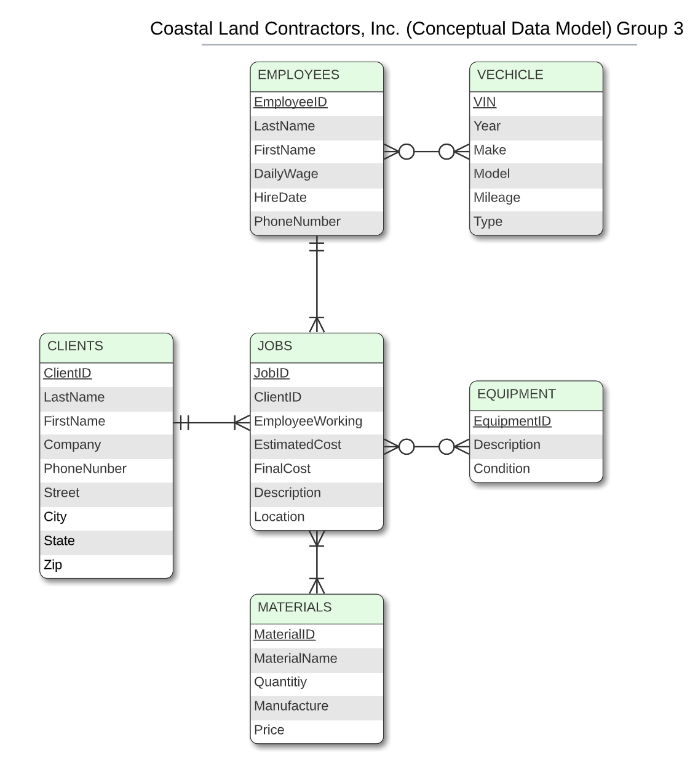
Conceptual Data Model

Slide 8
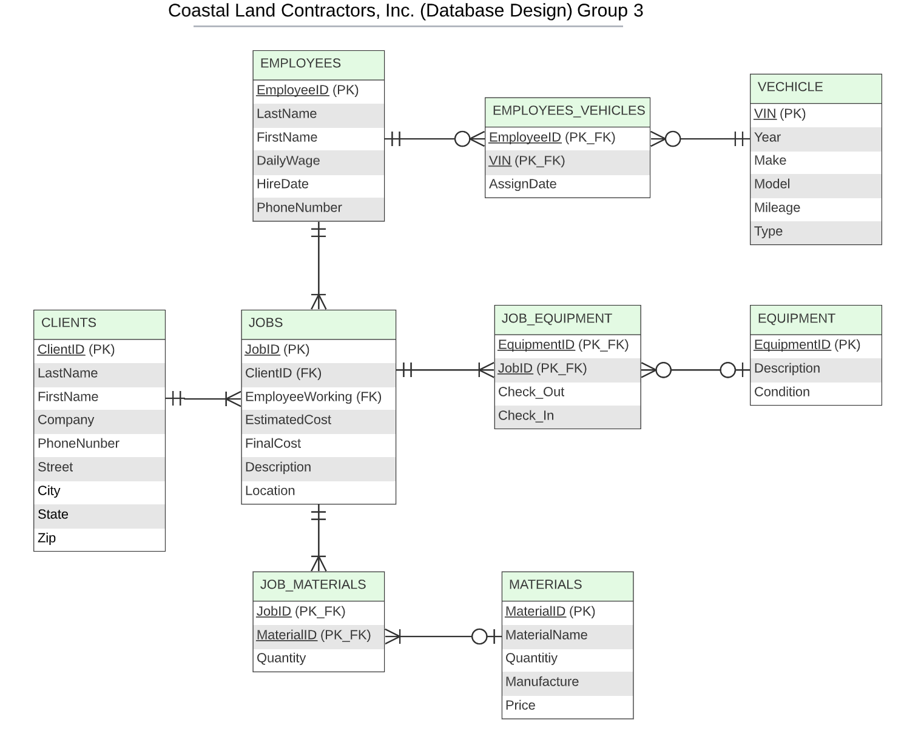
Logical and Physical Data Model

Slide 9
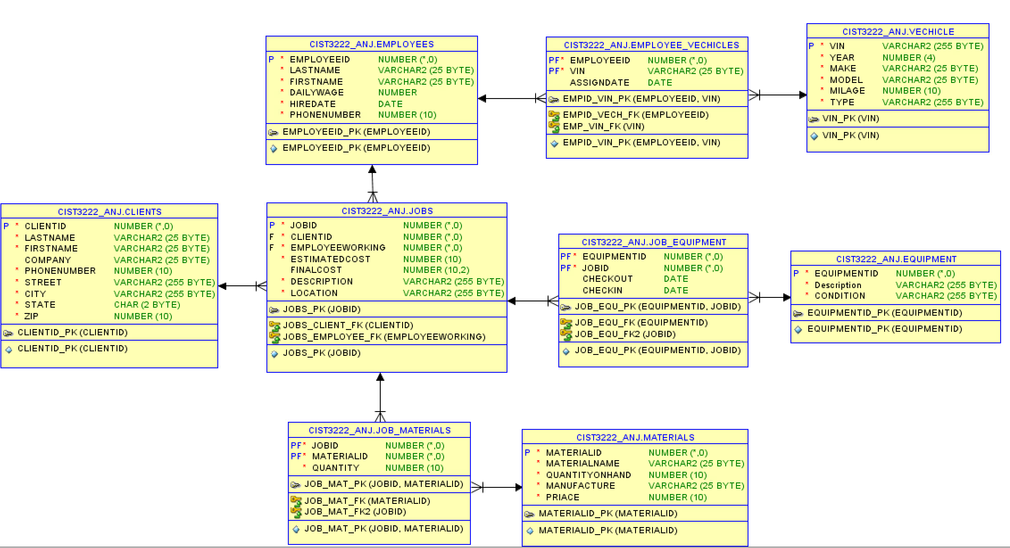
Database Implementation

Slide 10
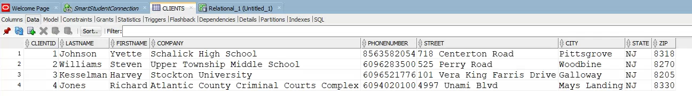
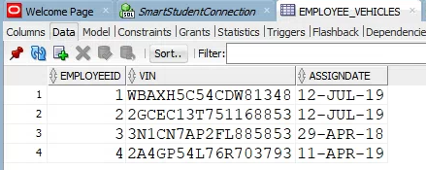
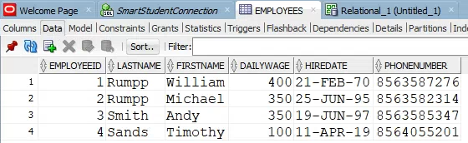
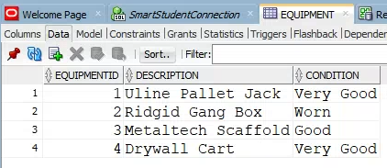
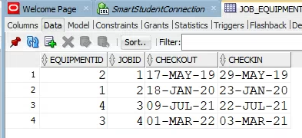

Slide 11
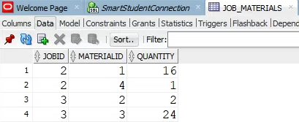
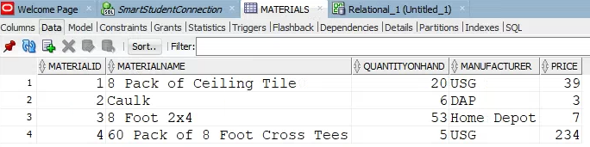
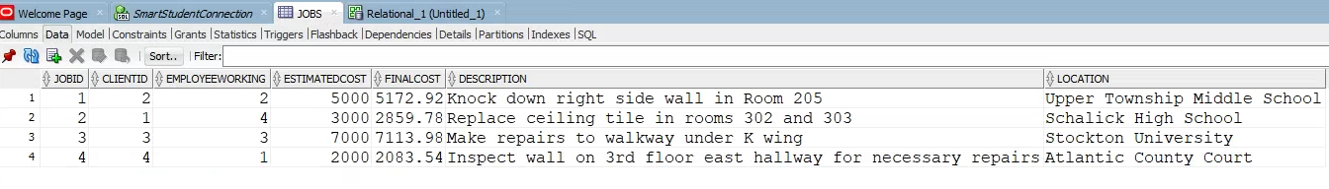
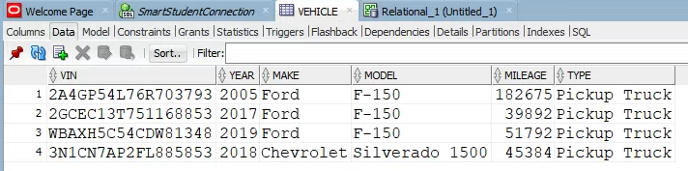

Slide 12


